Slide 1
MATHEMATICAL FOUNDATION FOR COMPUTER SCIENCE
Prepared by: Er. Ankit Kharel
Nepal college of information technology

Slide 2
Recurrence relations
Recursive Definition of Sequences.
Solution of Linear Recursive Relation
Solution of Non-linear Recurrence Relation.

Slide 3
INTRODUCTION:
Consider the following:
a) Start with number 5
b) Given any term , add 3 to get next term
If we list the term using above rule then we obtain,
5, 8, 11, 14, 17, ……………-----------------------(i)
If we denote (i) as a₁ , a₂ , a₃ , a₄ , …….., We may rephrase above instruction as:
a_{n} = a_{n – 1} + 1 ; with initial condition, a₁ = 5, n≥2
RECURRENCE RELATION
If a sequence can be expressed by an equation in terms of previous element then it is called the Recurrence Relation and the equation that satisfies the recurrence relation is called solution of recurrence relation.

Slide 4
INTRODUCTION:
Fibonacci Sequence:
0, 1, 1, 2, 3, 5, 8, 13, 21, …………………………………
It can be generated by using following recurrence relation,
F_{n} = F_{n-1} + F_{n-2} ; F₀ =0,F₁=1
a_{n} = 2a_{n-1} – a_{n-2} ; a₁=3, a₂=6……… for n= 2, 3, 4…..
check whether a_{n} = 3n is its solution ?
a_{n} = 2 [3 {n-1}] – 3 [n-2] = 6n - 2 - 3n + 2 = 3n
Hence, a_{n} = 3n is its solution.

Slide 5
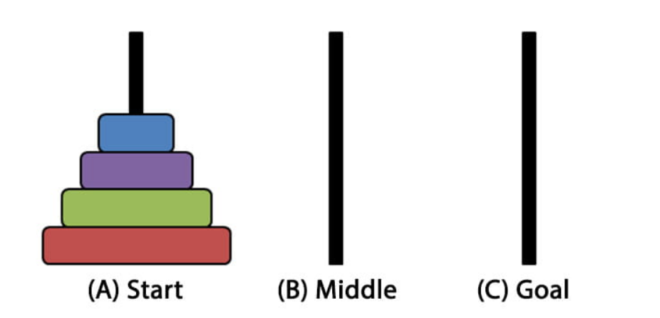
Tower of Hanoi:
Tower of Hanoi is a mathematical puzzle where we have three rods and n disks. The objective of the puzzle is to move the entire stack to another rod, obeying the following simple rules: 1) Only one disk can be moved at a time. 2) Each move consists of taking the upper disk from one of the stacks and placing it on top of another stack i.e. a disk can only be moved if it is the uppermost disk on a stack. 3) No disk may be placed on top of a smaller disk.

Slide 6
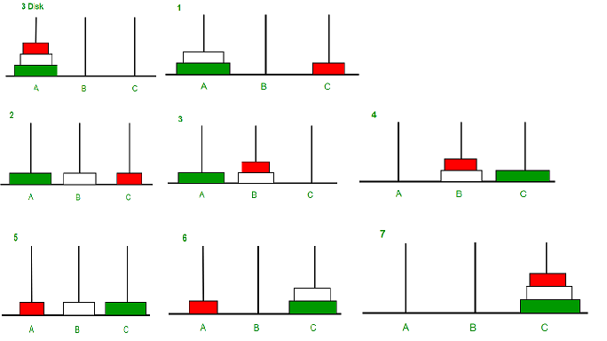
Tower of Hanoi:
Let, H_{n} be the total moves required to move n disk from peg-1 to peg-3.
First with the help of peg-2 & peg-3, move (n-1) disks from peg-1 are arranged to peg-2.
This requires, H_{n-1} moves.
Then, largest disk from peg-1 is moved to peg-3, which requires 1 move.
iii) Finally, (n-1) disks of peg-2 are moved to peg-3 with the help of peg-1 & peg-2.
This requires further H_{n-1} moves.
Hence, We can define a recurrence relation as:
H_{n} = H_{n-1} + 1 + H_{n-1}
H_{n} = 2H_{n-1} + 1

Slide 7
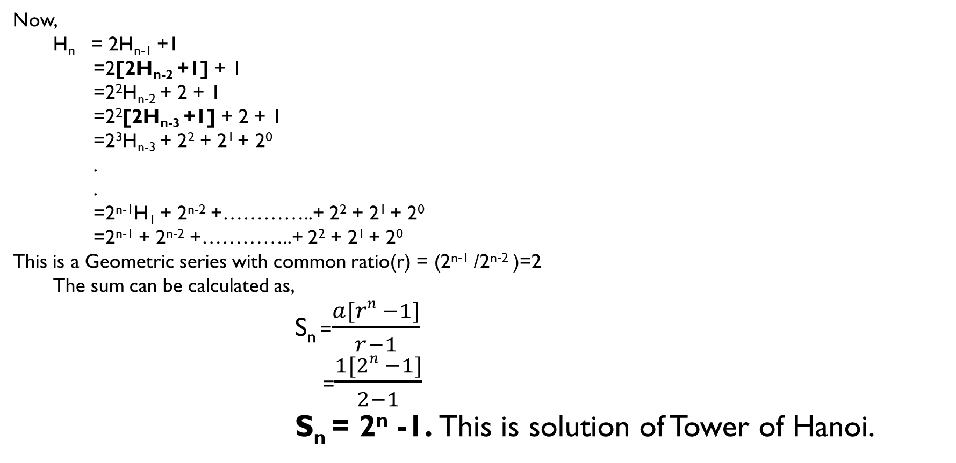
Tower of Hanoi:
Now,
H_{n} = 2H_{n-1} +1
=2[2H_{n-2} +1] + 1
=2²H_{n-2} + 2 + 1
=2²[2H_{n-3} +1] + 2 + 1
=2³H_{n-3} + 2² + 2¹ + 2⁰
.
.
=2^{n-1}H₁ + 2^{n-2} +…………..+ 2² + 2¹ + 2⁰
=2^{n-1} + 2^{n-2} +…………..+ 2² + 2¹ + 2⁰
This is a Geometric series with common ratio(r) = (2^{n-1} /2^{n-2} )=2
The sum can be calculated as,
S_{n} =$\frac{a[rn −1]}{r−1}$
=$\frac{1[2n −1]}{2−1}$
S_{n} = 2^{n} -1. This is solution of Tower of Hanoi.

Slide 8
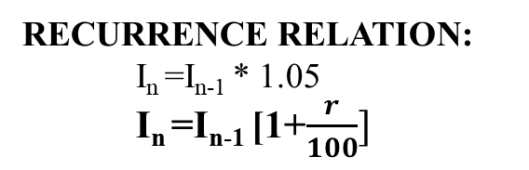
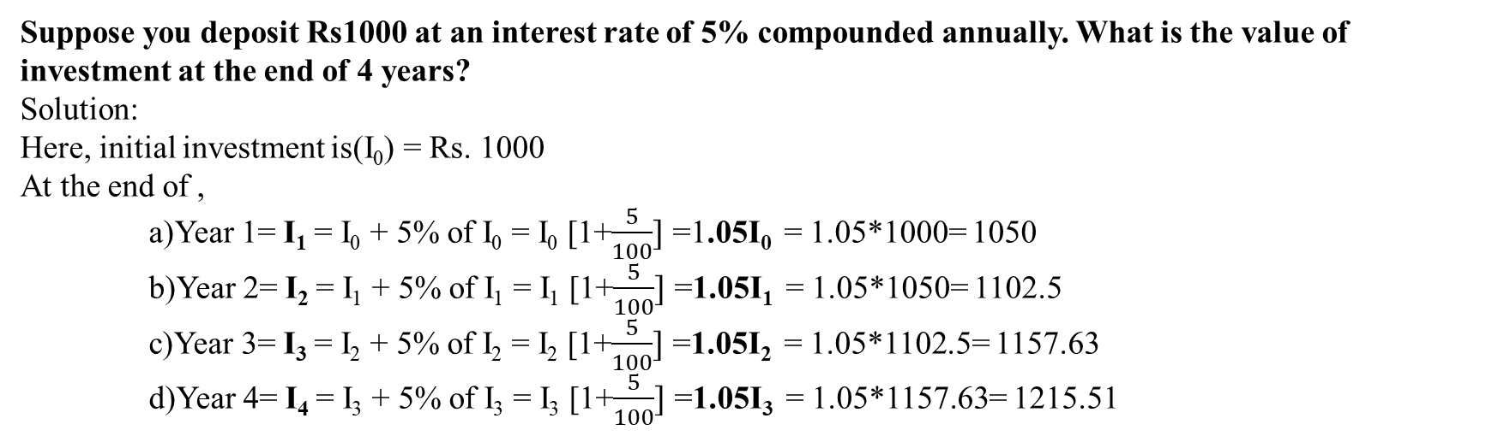
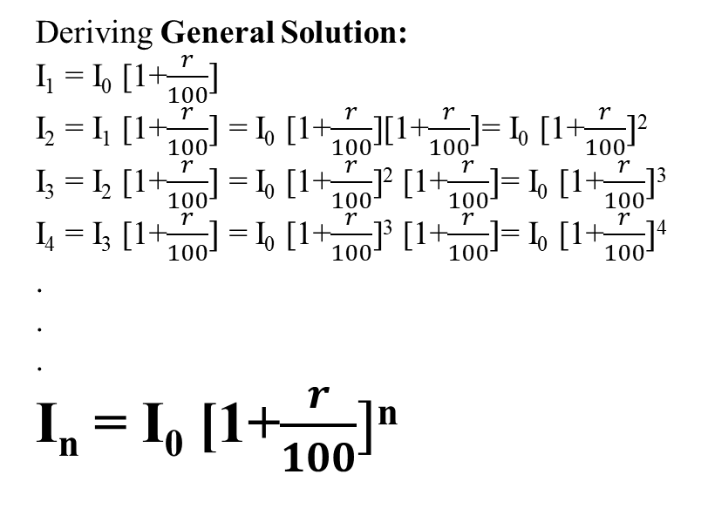
Suppose you deposit Rs1000 at an interest rate of 5% compounded annually. What is the value of investment at the end of 4 years?
Solution:
Here, initial investment is(I₀) = Rs. 1000
At the end of ,
a)Year 1= I₁ = I₀ + 5% of I₀ = I₀ [1+$\frac{5}{100}]$ =1.05I₀ = 1.05*1000= 1050
b)Year 2= I₂ = I₁ + 5% of I₁ = I₁ [1+$\frac{5}{100}]$ =1.05I₁ = 1.05*1050= 1102.5
c)Year 3= I₃ = I₂ + 5% of I₂ = I₂ [1+$\frac{5}{100}]$ =1.05I₂ = 1.05*1102.5= 1157.63
d)Year 4= I₄ = I₃ + 5% of I₃ = I₃ [1+$\frac{5}{100}]$ =1.05I₃ = 1.05*1157.63= 1215.51
RECURRENCE RELATION:
I_{n} =I_{n-1} * 1.05
I_{n} =I_{n-1} [1+$\frac{r}{100}]$
Deriving General Solution:
I₁ = I₀ [1+$\frac{r}{100}]$
I₂ = I₁ [1+$\frac{r}{100}]$ = I₀ [1+$\frac{r}{100}$][1+$\frac{r}{100}]$= I₀ [1+$\frac{r}{100}]$²
I₃ = I₂ [1+$\frac{r}{100}]$ = I₀ [1+$\frac{r}{100}$]² [1+$\frac{r}{100}]$= I₀ [1+$\frac{r}{100}]$³
I₄ = I₃ [1+$\frac{r}{100}]$ = I₀ [1+$\frac{r}{100}$]³ [1+$\frac{r}{100}]$= I₀ [1+$\frac{r}{100}]$⁴
.
.
.
I_{n} = I₀ [1+$\frac{r}{100}]$^{n}

Slide 9
Q. Suppose that a person invests Rs. 2000 at 14% compounded annually.
a) Find the recurrence relation.
b) Find the initial condition.
c) Find A₁ , A_{2,} A₃ .
d) Find an explicit formula .
e) How long will it take for a person to double the initial investment?
Solution:
Let, A_{n} be the amount after n years
Initial investment(A₀) = Rs. 2000
Recurrence Relation:
A₁ = A₀ + 14% of A₀
i.e. A₁ = (1.14)A₀
A₂ = (1.14) A₁
A_{n} = (1.14)A_{n-1}
b) Initial condition:
Since the initial investment is A₀ = Rs. 2000 . A₀ = Rs. 2000 is the initial condition.
c) A₁ , A_{2,} A₃
i) A₁ = (1.14)A₀ = 1.14*2000=2280
ii) A₂ = (1.14)A₁ = 1.14*2280=2599.2
iii) A₃ = (1.14)A₂ = 1.14*2599.2=2963.088

Slide 10
d) Explicit Formula:
We have,
A₁ = (1.14)A₀
A₂ = (1.14)A₁ = (1.14)² A₀
A₂ = (1.14)A₂ = (1.14)³ A₀
.
.
.
A_{n} =(1.14)^{n} A₀ = (1.14)^{n} A_{n-1}
e)Years to double the investment:
Initial Investment(A₀) = 2000
Final Investment(A_{n}) = 2A₀ = 4000
Using the explicit formula,
A_{n} = (1.14)^{n} 2000
4000 = (1.14)^{n} 2000
(1.14)^{n} = 2
n = 5.29 Years

Slide 11
Q. A patient is injected with 160ml of a drug. Every 6 hours 25% of the drug passes out of her bloodstream. To compensate, a further 20ml dose is given every 6 hours.
Find the recurrence relation for the amount of drug in the bloodstream
Use the relation to find the amount of drug remaining after 24 hours.
Solution:
Let initial dose=U₀ = 160ml
After 6 hours 25% of drug passes out. So remaining = 75% and every hour 20ml is added
Now,
U₁ = (0.75)U₀ + 20
U₂ = (0.75)U₁ + 20
U_{n} = (0.75)U_{n-1} + 20, is the recurrence relation
b) Drug remaining after 24 hours:
(After 6 hours) U₁ = (0.75)U₀ + 20 = 0.75*160 + 20 = 140
(After 12 hours) U₂ = (0.75)U₁ + 20 = 0.75*140 + 20 = 125
(After 18 hours) U₃ = (0.75)U₂ + 20 = 0.75*125 + 20 = 113.75
(After 24 hours) U₄ = (0.75)U₃ + 20 = 0.75*113.75 + 20 = 105.3125

Slide 12
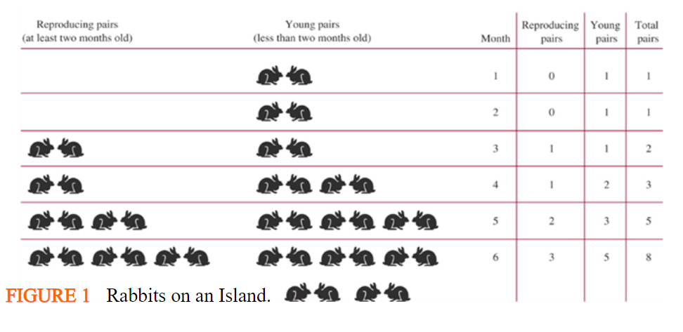
Rabbits population:
A young pair of rabbits, one of each sex, is placed on an island. A pair of rabbits does not breed until they are 2 months old. After they are 2 months old, each pair of rabbits produces another pair each month. Assume that none of the rabbits die. How many rabbits are there after n months?
Let f_{n} denote the number of pairs of rabbits after n months.
f₁ = 1 { reproducing pairs = 0, young pairs = 1 }
f₂ = 1 { reproducing pairs = 0, young pairs = 1 }
f₃ = 2 { reproducing pairs = 1, young pairs = 1 }
f₄ = 3 { reproducing pairs = 1, young pairs = 2 }
f₅ = 5 { reproducing pairs = 2, young pairs = 3 }
The number of pairs of rabbits after n months fn is equal to the number of pairs of rabbits from the previous month fn-1 plus the number of pairs of newborn rabbits, which equals fn-2, since each newborn pair comes from a pair that is at least two months old, so
F_{n} = F_{n-1} + F_{n-2} for n >= 3.

Slide 13
An employee joined a company in 2019 with a starting salary of NRs.750000 annually. Every year this employee receives a raise of NRs.50000 plus 3% of the salary of the previous year. Set up a recurrence relation for the salary of the employee after n years from 2019. Find explicit solution. Also find the annual salary of the employee in 2029.
Solution:
Starting Salary(S₀) = Rs. 750000
Raise in salary(R) = 50000 + 0.03S; where S is the salary of previous Year.
Now,
Salary after one year(S₁) = S₀ + 50000 + 0.03S₀ = 50000 + 1.03S₀
Salary after two year(S₂) = S₁ + 50000 + 0.03S₁ = 50000 + 1.03S₁
Salary after three year(S₃) = S₂ + 50000 + 0.03S₂ = 50000 + 1.03S₂
Therefore recurrence relation is given by:
S_{n} = 50000 + 1.03S_{n-1}
= 50000 + 1.03[50000 + 1.03S_{n-2}]
=50000 + (1.03)50000 + (1.03)²S_{n-2}
=50000 + (1.03)50000 + (1.03)²[50000 + 1.03S_{n-3}]
=50000 + (1.03)50000 + (1.03)²50000 + (1.03)³S_{n-3}
.
.
=50000 + (1.03)50000 + (1.03)²50000 + (1.03)³50000 + …….+ (1.03)^{n-1}50000 + (1.03)^{n} S₀

Slide 14
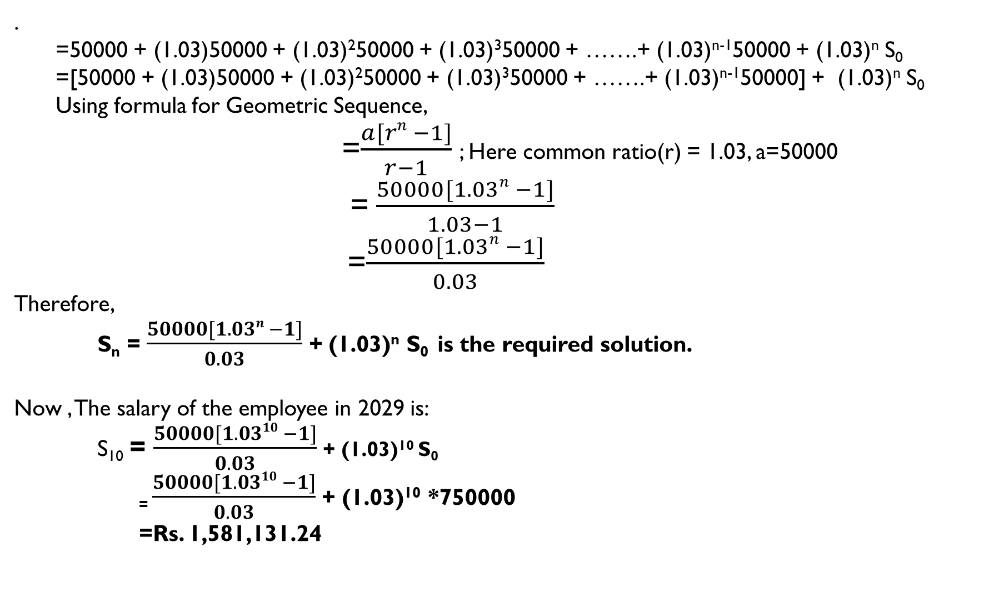
.
=50000 + (1.03)50000 + (1.03)²50000 + (1.03)³50000 + …….+ (1.03)^{n-1}50000 + (1.03)^{n} S₀
=[50000 + (1.03)50000 + (1.03)²50000 + (1.03)³50000 + …….+ (1.03)^{n-1}50000] + (1.03)^{n} S₀
Using formula for Geometric Sequence,
=$\frac{a[rn −1]}{r−1}$; Here common ratio(r) = 1.03, a=50000
=$\frac{50000[1.03n −1]}{1.03−1}$
=$\frac{50000[1.03n −1]}{0.03}$
Therefore,
S_{n} = $\frac{50000[1.03n −1]}{0.03}$ + (1.03)^{n} S₀ is the required solution.
Now , The salary of the employee in 2029 is:
S₁₀ = $\frac{50000[1.0310 −1]}{0.03}$ + (1.03)¹⁰ S₀
₌ $\frac{50000[1.0310 −1]}{0.03}$ + (1.03)¹⁰ *750000
=Rs. 1,581,131.24

